Slide 1

Innovative Thinking Lab

Slide 2

Innovative Thinking Lab. was founded with the aim of supporting the creation of ecosystems in the "existence" and development processes of individuals and communities in the globalizing world and to create an innovative effect on thought systems.

Slide 3

OUR GOALS
Our organization aims to develop;
Analytical thinking,
Creativity, innovation,
Digital skills and problem solving
At local and national levels in the face of poverty, migration, youth unemployment, social exclusion, climate change and environmental problems.
Carries out trainings and projects with a holistic approach and a multicultural working/learning environment.

Slide 4


Problem Solving
Analytical Thinking
Information Communication Technologies
Creativity
21. Yüzyıl Becerileri
Leadership
Entrepreneurship

Slide 5
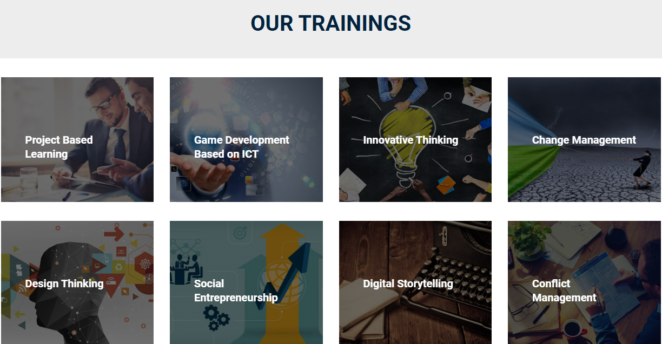


Slide 6

WHO ARE WE WORKING WITH IN THIS TEAM?
As Innovative Thinking Lab, we work with many people from different age groups, various universities, municipalities and non-governmental organizations.

Slide 7

OUR PROJECTS
National Projects
Workshops and trainings

Slide 8

International Projects
CREATIVE YOUTH WORK
Program: Erasmus+ Program for support education, training, youth and sport in Europe
Project Name: International Training Course in Creative Youth Work
Start Date: 01/03/2021, Total Duration: 6 months
International Training Course in Creative Youth Work’s aim is to develop a shared sense of importance of (creative) youth work and link it to different global issues: diversity, climate change, democracy… and how creative youth work can play a role in giving children and youngsters an outlet of expression.
Partners:

Slide 9


International Projects
Program: Erasmus+ KA2 - Partnerships for Creativity / Adult Education
Project Name: Innovative Approche in Adult Education : Digital Storytelling in Intergenerational Learning
Start Date: 01/03/2021, Total Duration: 24 months
E- SHAHRAZAD project aims to bridge the gap between the young generation and the adult generation using stories, which have been the best means of learning in every era from past to present.
Partners:

Slide 10

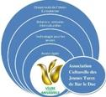



International Projects
Program: Erasmus+ Program for support education, training, youth and sport in Europe
Project Name: A Virtual Museum as a Tool for Creative Advocacy for Social Inclusion
Start Date: 01/03/2021, Total Duration: 12 months
CreActive Project aims to engage, connect and empower youth through art and creativity, and create sustainable connections between youth workers, schools and social organizations on an European level.
Partners:

Slide 11
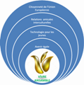




International Projects
iNSPIRE
Program: Erasmus+ KA220-VET Cooperation partnerships in vocational education and training
Project Name: Innovation for Social Entrepreneurship
Start Date: 01/11/2021, Total Duration: 24 months
iNSPIRE Project’s aim is to improve and reinforce the young entrepreneurs' capacity to respond to the challenges that the labor markets are facing during the COVID-19 pandemic or will face on future similar challenges.
Partners:

Slide 12



International Projects
GREEN CARE
Program: KA153-YOU - Mobility of youth workers
Project Name: Promoting Mental Wellbeing of Youth People
Start Date: 01/08/2021, Total Duration: 12 months
Green Care: Promoting Mental Wellbeing of Youth People’s aim is to is to build the capacity of youth workers to promote mental wellbeing of marginalised young people through the valorisation of local natural resources and the evolution of youth work systems.
Partners:

Slide 13

THANK YOU FOR LISTENING!

